Slide 1


A PRESENTATION
ON
AI-Driven Fake News Detection Using Hybrid Machine Learning and Deep Learning Models
Submitted in partial fulfillment of the requirements
for the award of the degree of
Bachelor of Technology
in
Computer Science and Engineering
by
Harsh Pratap Singh Chauhan - 2100970100052 Anmol Agrawal – 2100970100019
Animesh Pratap Singh - 2100970100014
Semester – VII
Under the Supervision of
Dr. Priyanka Tyagi (Asst. Professor-3)
Galgotias College of Engineering & Technology
Greater Noida - 201306
Affiliated to
Dr. APJ Abdul Kalam Technical University, Lucknow (Session: 2024-2025)

Slide 2
introduction
The rapid spread of fake news through social media undermines public trust, social stability, and democratic processes, influencing public opinion, elections, healthcare, and financial markets.
Machine learning techniques such as Logistic Regression and Decision Trees are commonly used to distinguish between real and fake news, with Random Forest enhancing accuracy by combining multiple decision trees.
Advanced methods like Support Vector Machines and Naive Bayes improve detection by managing high-dimensional data and classifying large feature sets effectively.
Deep learning models, including Convolutional Neural Networks and BERT, further enhance detection capabilities by recognizing subtle patterns and contextual meanings in text, leading to a more robust and adaptable detection system.

Slide 3
Literature survey
Year | Author(s) | Proposed Method | Limitation | Tools
2017 | Shu et al. [1] | Survey on fake news detection methods and categorization | General overview; lacks specific implementation details | N/A
2020 | Ahmad et al. [2] | Machine learning ensemble approach with various textual features | Limited to textual features; less effective on multimodal data | Multiple machine learning algorithms
2022 | Palani et al. [3] | CB-Fake: Combines BERT for text and CapsNet for images | No comparative analysis with purely textual methods | BERT, CapsNet
2021 | Kaliyar et al. [4] | FakeBERT: Uses parallel CNNs with different kernel sizes and BERT | High computational requirements; complexity in model integration | Deep CNNs, BERT
2022 | Li et al. [5] | Self-learning semi-supervised deep learning network with a confidence layer | Dependency on labeled data; may struggle with diverse news sources | Deep learning network
2022 | Vitorino et al. [6] | LSTM, GRU, and BERT models for fake news detection | BERT outperforms LSTM and GRU; limited integration with multimodal features | LSTM, GRU, BERT
2019 | Qian et al. [7] | MCNN-TFW: Multi-level CNN with TF-IDF weighted features | Performance highly dependent on quality of sensitive word weight estimation | CNN, TF-IDF weighting
2019 | Jadhav et al. [8] | Enhanced RNN with Deep Structured Semantic Model (DSSM) | Requires significant training data; may not generalize well to unseen data | RNN, DSSM

Slide 4
Year | Author(s) | Proposed Method | Limitation | Tools
2021 | Ullah et al. [9] | Ensemble deep learning with Bi-LSTM-GRU-dense model for textual attributes | Focuses mainly on textual attributes; might overlook multimodal aspects | Bi-LSTM-GRU-dense, Dense Model
2022 | Bedmar et al. [10] | Multimodal approach using CNN for integrating text and image data | Lower accuracy compared to some unimodal methods; relies on quality of image data | CNN, BERT (for unimodal comparison)
2021 | Chenguang et al. [11] | Hybrid deep learning with cross-modal attention residual network (CARN) and MCNN | Average performance due to exclusion of visual data; might miss contextual nuances | CARN, MCNN
2020 | Giachanou et al. [12] | Multimodal multi-image system integrating textual, visual, and semantic data | Complexity in handling and processing multiple modalities simultaneously | BERT, VGG-16
2019 | Khattar et al. [13] | Multimodal Variational Autoencoder (MVAE) integrating text and visual data | May require extensive computational resources; performance dependent on data quality | MVAE, Variational Autoencoder

Slide 5
. Need for the Proposed Research
Increasing spread of fake news on social media
Fake news becoming more convincing and harder to detect
Impact on public opinion, elections, and social stability
Current detection methods are outdated and ineffective
Need for a system that can detect fake news in real-time
Misinformation spreading across different languages and platforms
Growing need for a scalable detection system
Preventing economic losses and harm to democratic processes

Slide 6
.OBJECTIVES
Develop a detection system using ML and DL techniques to accurately identify fake news.
Improve detection accuracy by minimizing false positives and negatives.
Build a scalable solution for handling large data volumes.
Ensure adaptability by integrating mechanisms to counter new misinformation techniques.
Assess practical utility for social media platforms and news organizations.
Contribute to academic knowledge on ML and DL techniques in fake news detection.

Slide 7
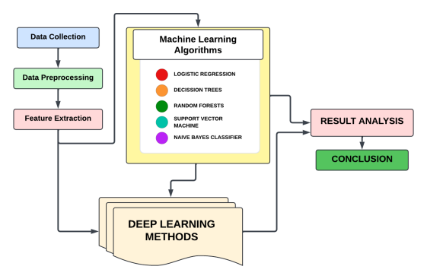
Methodology

Slide 8
Methodology
Data Collection & Preprocessing
Data Sources: FakeNewsNet, Kaggle (real and fake news articles, metadata)
Text Cleaning: Remove unwanted characters, tokenize, convert to lowercase, filter stopwords
Normalization: Lemmatization/Stemming to reduce words to their base form
6.2 Feature Extraction
Bag of Words (BoW): Simple word collection (ignores order)
TF-IDF: Weights words based on frequency within document & dataset
Word Embeddings: Word2Vec, GloVe for contextual understanding

Slide 9
Methodology
6.3 Machine Learning Models
Logistic Regression: For binary classification
Decision Trees: Clear decision rules, prone to overfitting
Random Forests: Combines multiple trees for better accuracy
Future Models: SVM, Naive Bayes for text classification
Deep Learning Models
CNNs: Identify local patterns in text, detect deceptive language
BERT: Understands context bidirectionally, useful for nuanced fake news detection
Model Training & Optimization
Train-Test Split: 80% training, 20% testing
Optimization: Grid search, cross-validation, SGD & Adam algorithms
Loss Function: Binary cross-entropy

Slide 10
conclusion
Our methodology for detecting fake news combines a range of techniques to effectively identify misinformation. We use diverse data sources and preprocess text to ensure clean, useful inputs for our models. By employing various machine learning methods, including Logistic Regression, Decision Trees, and Random Forests, alongside advanced deep learning models like CNNs and BERT, we aim to improve detection accuracy. Our approach involves rigorous model training and evaluation, focusing on accuracy and reliability. This comprehensive strategy ensures that our fake news detection system is robust and adaptable to evolving challenges.

